Slide 1

CSP05
ALGORITHMS &
COMPLEXITY

Slide 2
CHAPTER I: BASIC CONCEPTS ON ALGORITHMS AND COMPLEXITY
PRELIMS
ALGORITHMS

Slide 3
ALGORITHMS
Algorithm is a set of finite, well-defined steps or instructions designed to solve a problem or perform a computation. It can also be defined as a procedure for solving a mathematical or computational problem in a finite number of steps, often involving repetitive or recursive operations.

Slide 4
ALGORITHMS
Need for Algorithms:
Solve complex problems efficiently and effectively.
Automate processes, making them reliable, faster, and easier.
Enable computers to perform tasks difficult or impossible for humans.
Widely used in mathematics, computer science, engineering, finance, and data analysis.

Slide 5
ALGORITHMS
Set of rules to obtain the expected output from the given input
INPUT
OUTPUT

Slide 6
ALGORITHMS

Slide 7
COMPLEXITY
This refers to the amount of resources (usually time or memory) that an algorithm consumes as the size of the input increases. We don't measure this in seconds (because hardware varies), but in the growth of operations.

Slide 8
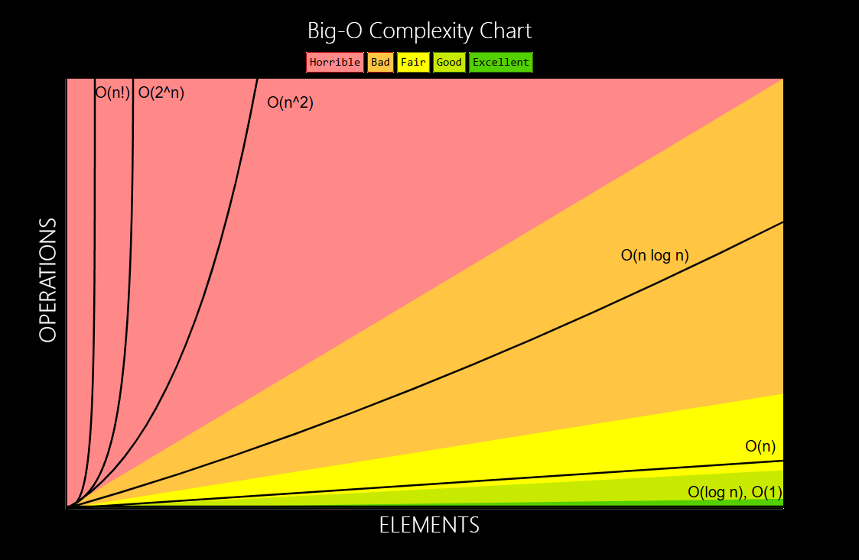
COMPLEXITY

Slide 9
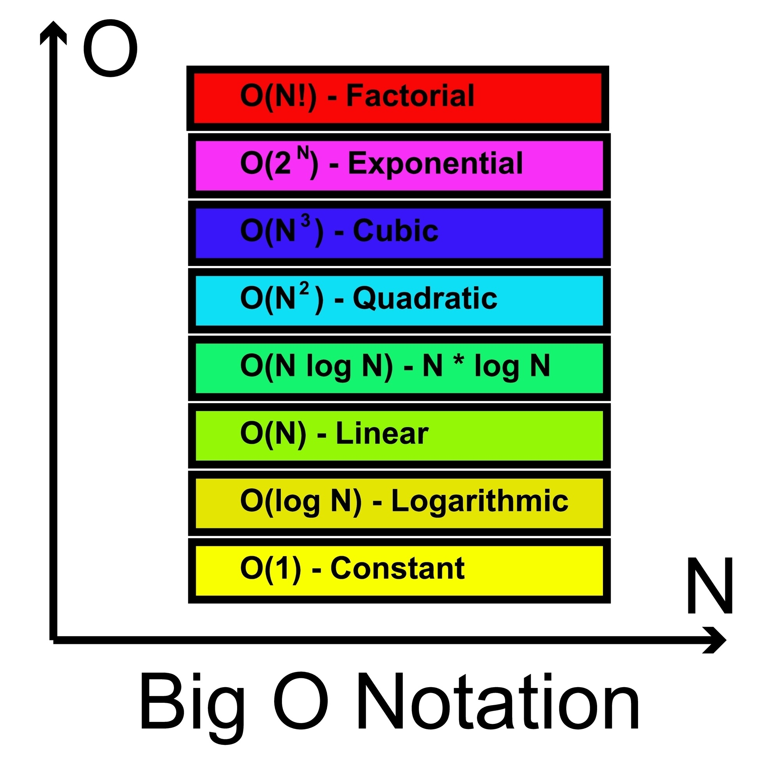
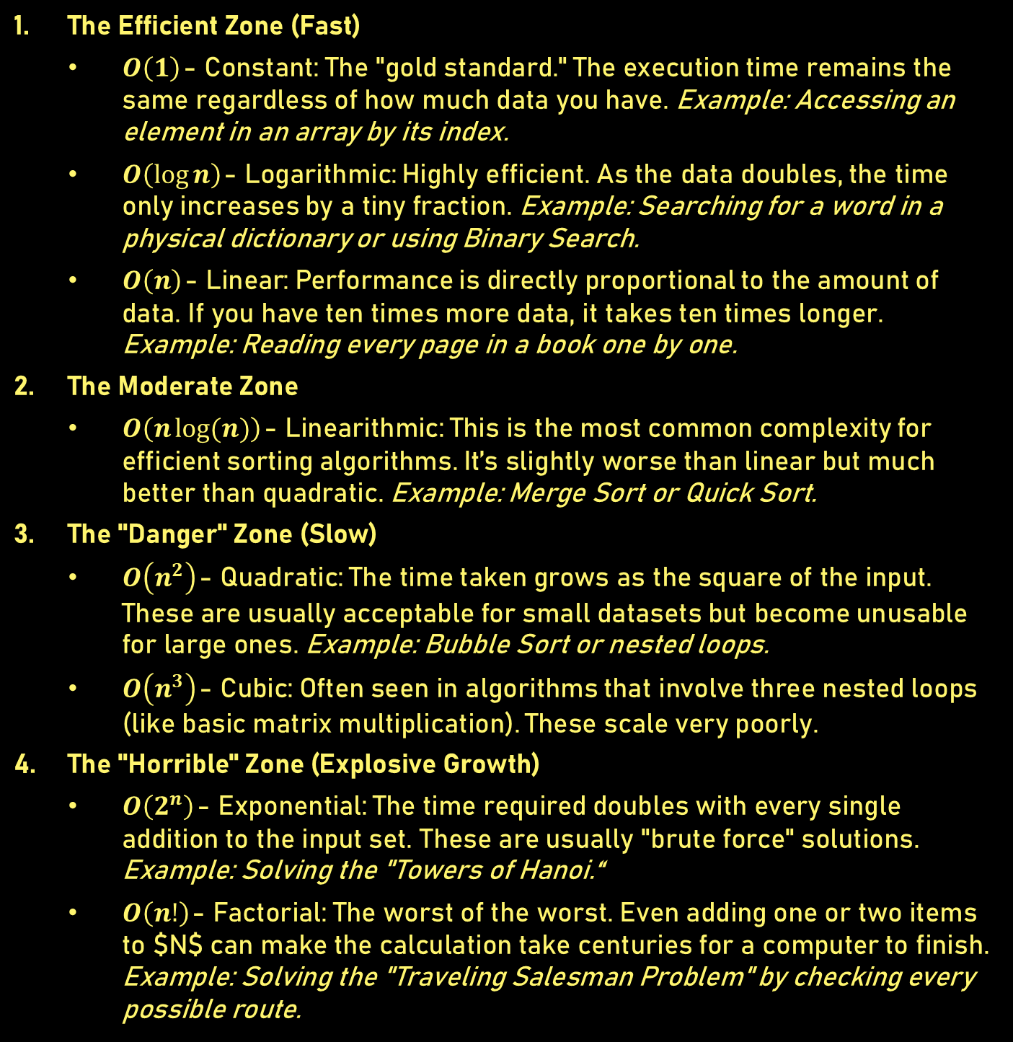
COMPLEXITY
The Efficient Zone (Fast)
$O\left(1\right)$ - Constant: The "gold standard." The execution time remains the same regardless of how much data you have. Example: Accessing an element in an array by its index.
$O\left(\log{n}\right)$ - Logarithmic: Highly efficient. As the data doubles, the time only increases by a tiny fraction. Example: Searching for a word in a physical dictionary or using Binary Search.
$O\left(n\right)$ - Linear: Performance is directly proportional to the amount of data. If you have ten times more data, it takes ten times longer. Example: Reading every page in a book one by one.
The Moderate Zone
$O\left(n\log{(n)}\right)$ - Linearithmic: This is the most common complexity for efficient sorting algorithms. It’s slightly worse than linear but much better than quadratic. Example: Merge Sort or Quick Sort.
The "Danger" Zone (Slow)
$O\left(n^{2}\right)$ - Quadratic: The time taken grows as the square of the input. These are usually acceptable for small datasets but become unusable for large ones. Example: Bubble Sort or nested loops.
$O\left(n^{3}\right)$ - Cubic: Often seen in algorithms that involve three nested loops (like basic matrix multiplication). These scale very poorly.
The "Horrible" Zone (Explosive Growth)
$O\left(2^{n}\right)$ - Exponential: The time required doubles with every single addition to the input set. These are usually "brute force" solutions. Example: Solving the "Towers of Hanoi.“
$O\left(n!\right)$ - Factorial: The worst of the worst. Even adding one or two items to $N$ can make the calculation take centuries for a computer to finish. Example: Solving the "Traveling Salesman Problem" by checking every possible route.
The chart is organized from the most efficient (bottom) to the least efficient (top).

Slide 10
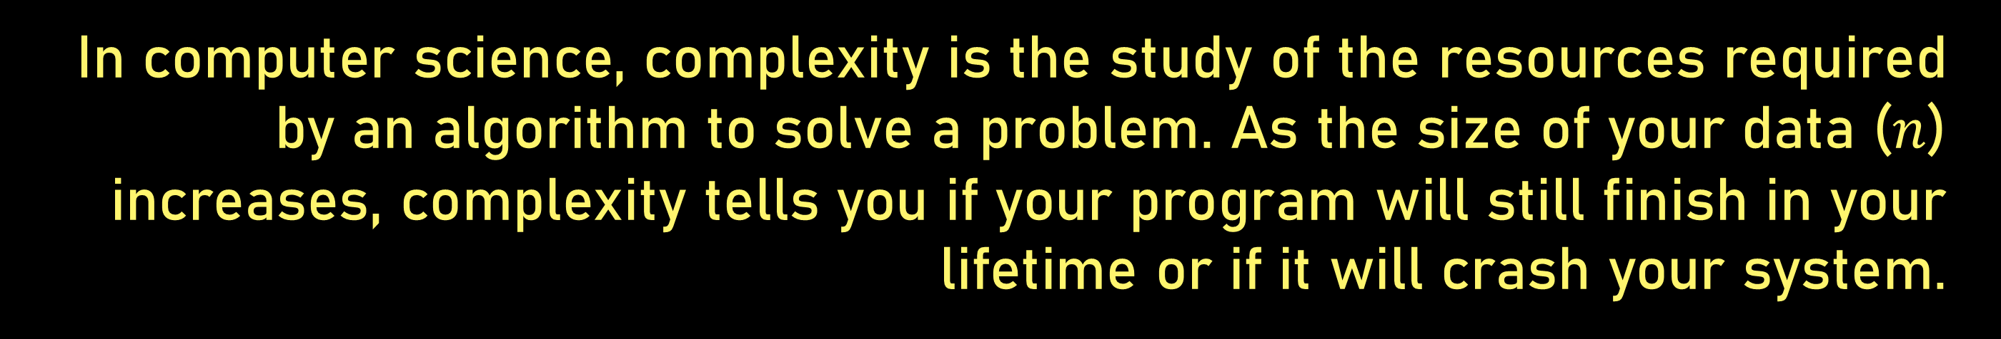
COMPLEXITY
In computer science, complexity is the study of the resources required by an algorithm to solve a problem. As the size of your data ($n$) increases, complexity tells you if your program will still finish in your lifetime or if it will crash your system.

Slide 11
COMPLEXITY
CPU Time (Time Complexity)
Main memory space (Space Complexity)

Slide 12
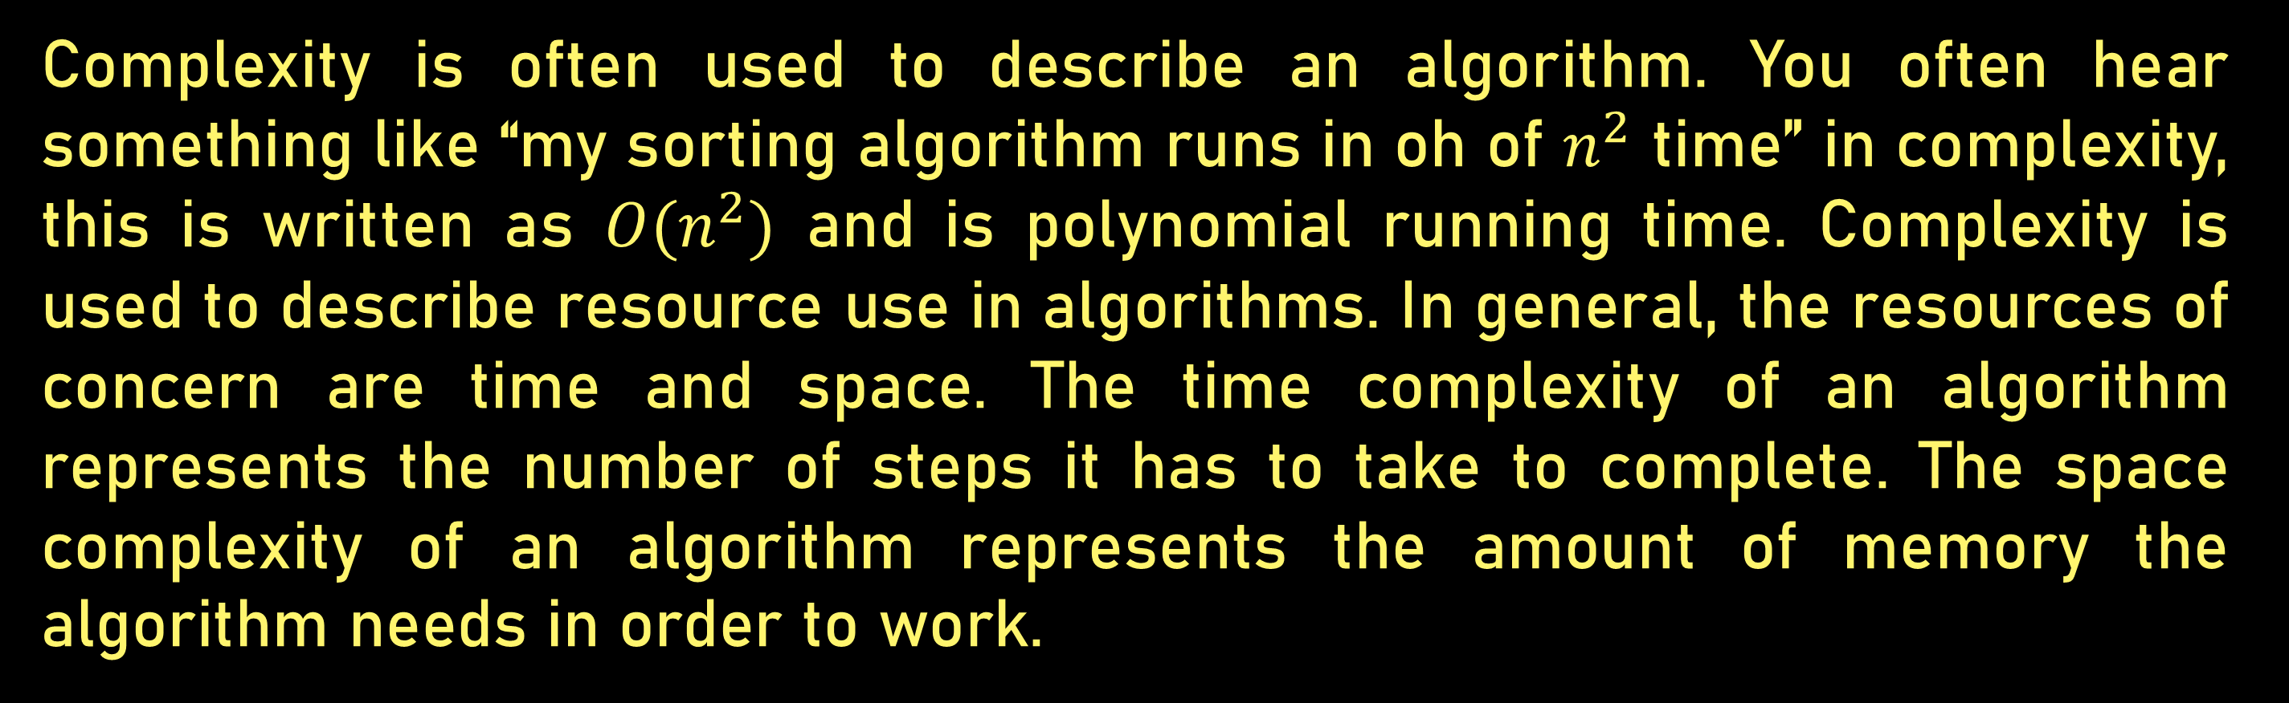
COMPLEXITY
Complexity is often used to describe an algorithm. You often hear something like “my sorting algorithm runs in oh of $n^{2}$ time” in complexity, this is written as ${O(n}^{2})$ and is polynomial running time. Complexity is used to describe resource use in algorithms. In general, the resources of concern are time and space. The time complexity of an algorithm represents the number of steps it has to take to complete. The space complexity of an algorithm represents the amount of memory the algorithm needs in order to work.

Slide 13

COMPLEXITY
In short, Time complexity describes the number of steps an algorithm must take relative to the size of the input.
Constant Time: An algorithm is considered constant time if it only performs a single operation on one element, regardless of how large the input size becomes.
$O\left(1\right)$

Slide 14
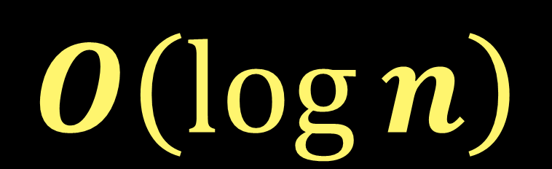
COMPLEXITY
In short, Time complexity describes the number of steps an algorithm must take relative to the size of the input.
Logarithmic: Time grows very slowly. Every time you double the data, you only add one extra step (e.g., Binary Search).
$O\left(\log{n}\right)$

Slide 15

COMPLEXITY
In short, Time complexity describes the number of steps an algorithm must take relative to the size of the input.
Linear Time: An algorithm takes linear time if each of the $n$ inputted elements is operated on exactly once.
$O\left(n\right)$

Slide 16
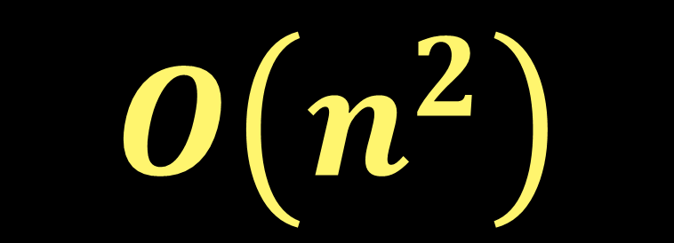
COMPLEXITY
In short, Time complexity describes the number of steps an algorithm must take relative to the size of the input.
Quadratic: Time grows exponentially with the data. If you double the data, the time quadruples (e.g., nested loops like Bubble Sort).
$O\left(n^{2}\right)$

Slide 17
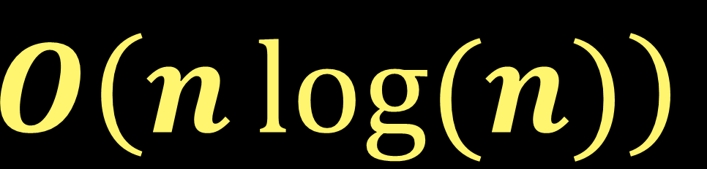
COMPLEXITY
In short, Time complexity describes the number of steps an algorithm must take relative to the size of the input.
Linearithmic: The standard for efficient sorting (e.g., Merge Sort or Quick Sort).
$O\left(n\log{(n)}\right)$

Slide 18

COMPLEXITY
In short, Time complexity describes the number of steps an algorithm must take relative to the size of the input.
Exponential: Doubling the data makes the time grow by an astronomical amount (e.g., recursive Fibonacci)
$O\left(2^{n}\right)$

Slide 19
To build a skyscraper, you need physics and to build a great algorithm, you need these three pillars:
Principles, Foundations, and Analysis
ALGORITHMS

Slide 20
To build a skyscraper, you need physics and to build a great algorithm, you need these three pillars:
ALGORITHMS
Principles, Foundations, and Analysis

Slide 21
ALGORITHMS

Slide 22
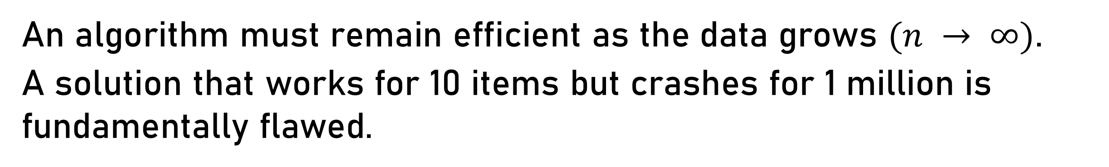
ALGORITHMS
Scalability First:
An algorithm must remain efficient as the data grows $(n → ∞)$.
A solution that works for 10 items but crashes for 1 million is fundamentally flawed.
Machine Independence:
Principles should focus on the "logic" rather than the hardware. We measure "operations" instead of "milliseconds."

Slide 23
ALGORITHMS
Correctness & Reliability:
An algorithm is only useful if it produces the correct output for all valid inputs, including edge cases.
The Efficiency Trade-off:
Design often involves a balance between Time (speed) and Space (memory). To make it faster, you often need more memory.

Slide 24
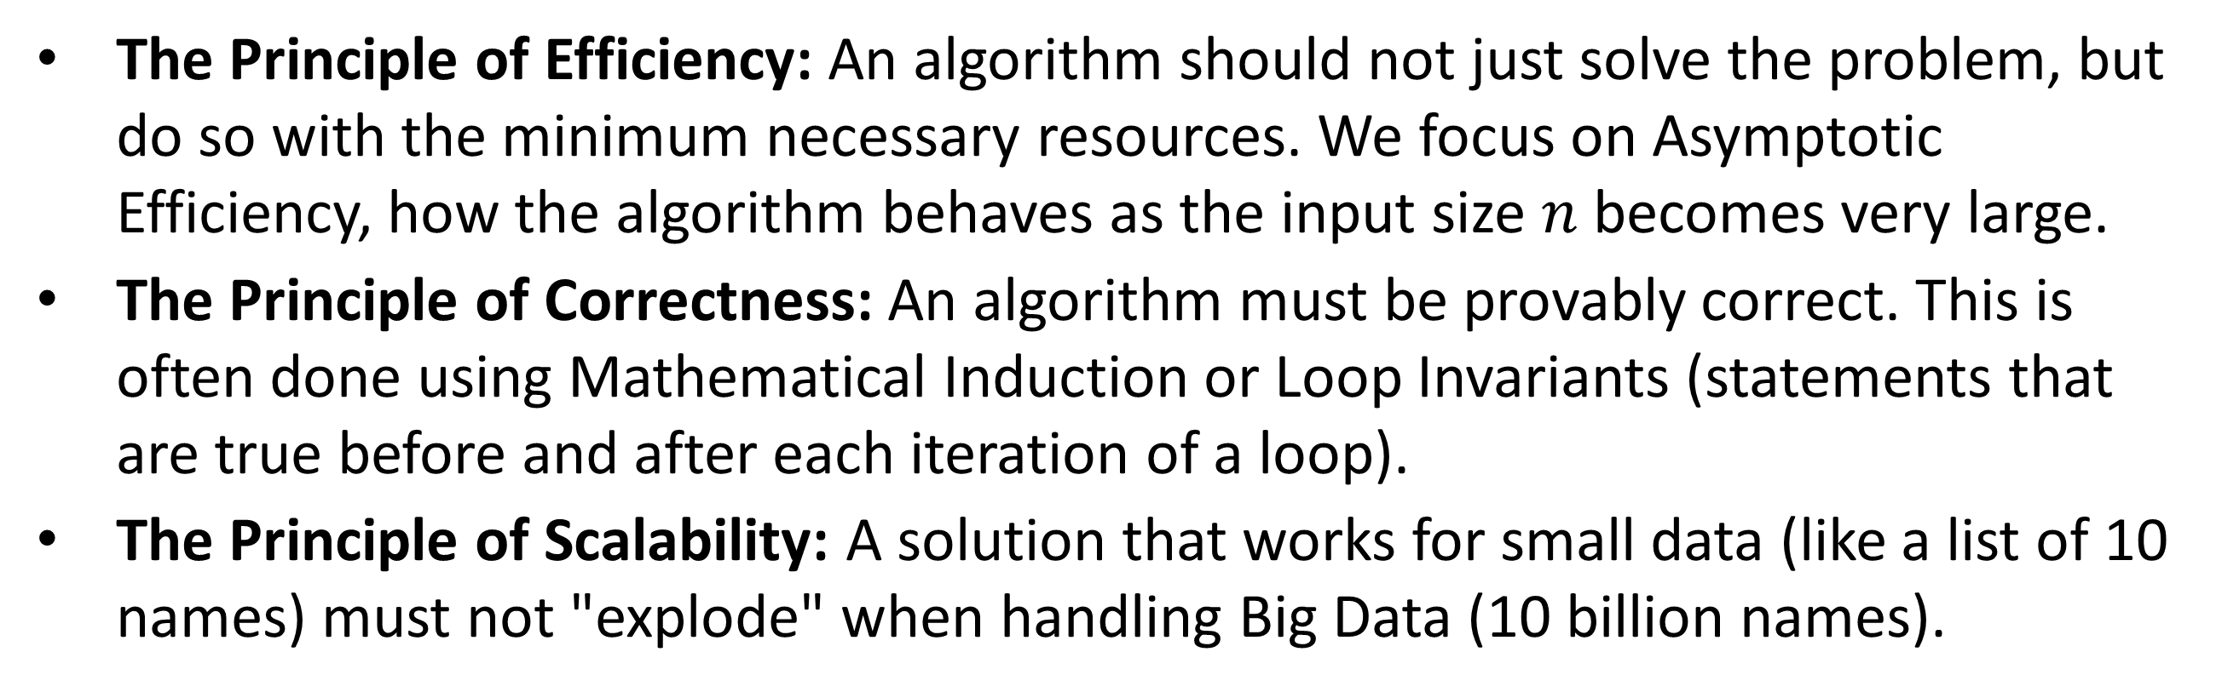
GUIDING PRINCIPLES OF ALGORITHMS
These are the "rules of thumb" that developers follow when designing logic.
The Principle of Efficiency: An algorithm should not just solve the problem, but do so with the minimum necessary resources. We focus on Asymptotic Efficiency, how the algorithm behaves as the input size $n$ becomes very large.
The Principle of Correctness: An algorithm must be provably correct. This is often done using Mathematical Induction or Loop Invariants (statements that are true before and after each iteration of a loop).
The Principle of Scalability: A solution that works for small data (like a list of 10 names) must not "explode" when handling Big Data (10 billion names).

Slide 25
GUIDING PRINCIPLES OF ALGORITHMS
These are the "rules of thumb" that developers follow when designing logic.
The Design Paradigm Principle: Good algorithms often follow established strategies:
Divide and Conquer: Breaking a problem into smaller identical sub-problems (e.g., Merge Sort).
Greedy Method: Making the best local choice at each step to find the global optimum (e.g., Dijkstra's Algorithm).
Dynamic Programming: Storing the results of sub-problems to avoid redundant work

Slide 26
GUIDING PRINCIPLES OF ALGORITHMS
These are the "rules of thumb" that developers follow when designing logic.
The Design Paradigm Principle: Good algorithms examples:
Divide and Conquer: Breaking a problem into smaller identical sub-problems (e.g., Merge Sort).
Greedy Method: Making the best local choice at each step to find the global optimum (e.g., Dijkstra's Algorithm).
Dynamic Programming: Storing the results of sub-problems to avoid redundant work

Slide 27
FOUNDATIONS OF ALGORITHMS
The mathematical and logical bedrock that makes algorithms possible.
Mathematical Foundations:
Discrete Mathematics: Set theory, functions, and relations are used to model data.
Graph Theory: Essential for algorithms involving networks, maps, or social media connections.
Probability: Used to analyze Randomized Algorithms (like QuickSort) where performance depends on random choices.

Slide 28
FOUNDATIONS OF ALGORITHMS
The mathematical and logical bedrock that makes algorithms possible.
Machine Foundations (The RAM Model):
In complexity analysis, we use the Random Access Machine (RAM) model. It assumes that basic operations (adding two numbers, accessing a memory location) take a constant amount of time regardless of where they are in memory.

Slide 29
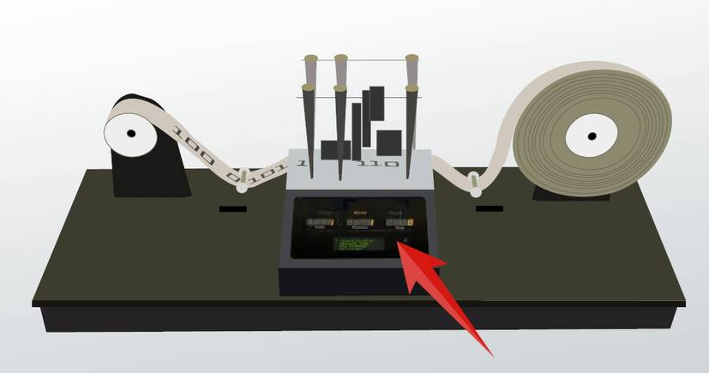
ANALYSIS OF ALGORITHMS
The scientific process of determining an algorithm’s "cost."
Computational Foundations:
The Church-Turing Thesis:
Proposed by Alan Turing
The idea that anything "computable" can be solved by an algorithm running on a Turing Machine. This sets the boundary of what computers can and cannot do.
Any effective calculation or computation that can be done by a human (following specific steps) can also be done by a Turing machine. A Turing machine is a simple mathematical model that represents a basic form of a computer. This machine helps explain the logic behind modern computers.
TURING MACHINE
Study.com. (n.d.). Turing Machine [Image]. https://study.com/cimages/videopreview/5ckbvtq4mp.jpg
a foundational, theoretical model of computation invented by Alan Turing in 1936 that defines the limits of algorithmic, mechanical calculation. It consists of an infinite, symbol-bearing tape, a read/write head, and a finite set of rules (states), which can simulate any computer algorithm by reading, writing, and moving along the tape.

Slide 30
WHY IS ANALYSIS OF ALGORITHM IMPORTANT?
Algorithm analysis is an important part of computational complexity theory, which provides theoretical estimation for the required resources of an algorithm to solve a specific computational problem. Analysis of algorithms is the determination of the amount of time and space resources required to execute it.
To predict the behavior of an algorithm for large inputs (Scalable Software).
It is much more convenient to have simple measures for the efficiency of an algorithm than to implement the algorithm and test the efficiency every time a certain parameter in the underlying computer system changes.
More importantly, by analyzing different algorithms, we can compare them to determine the best one for our purpose.

Slide 31
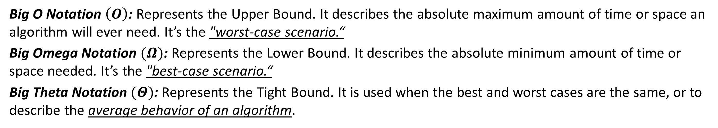
WHY IS ANALYSIS OF ALGORITHM IMPORTANT?
The scientific process of determining an algorithm’s "cost."
Asymptotic Analysis of Algorithms
This refers to the mathematical boundaries of an algorithm's performance as the input size $(n)$approaches infinity.
Big O Notation $\left(O\right)$: Represents the Upper Bound. It describes the absolute maximum amount of time or space an algorithm will ever need. It’s the "worst-case scenario.“
Big Omega Notation $(Ω)$: Represents the Lower Bound. It describes the absolute minimum amount of time or space needed. It’s the "best-case scenario.“
Big Theta Notation $(Θ)$: Represents the Tight Bound. It is used when the best and worst cases are the same, or to describe the average behavior of an algorithm.

Slide 32
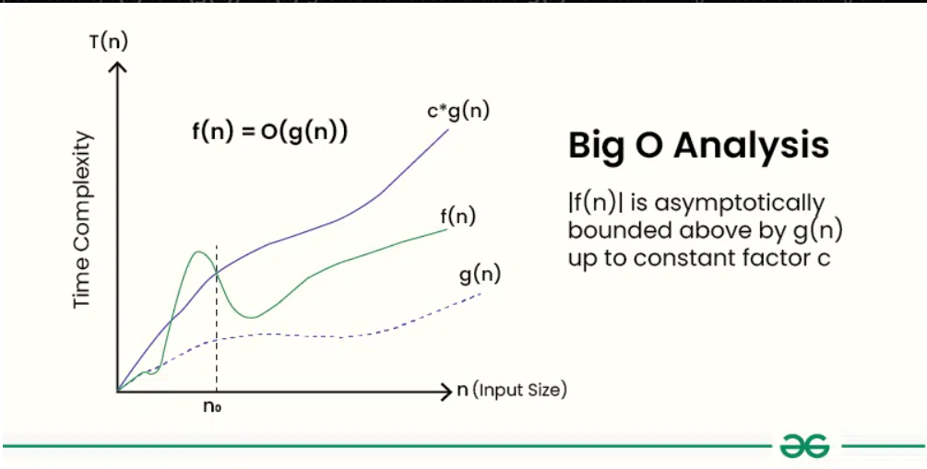
WHY IS ANALYSIS OF ALGORITHM IMPORTANT?
The scientific process of determining an algorithm’s "cost."
Big O notation is used to describe the time complexity or space complexity of algorithms. Big-O is a way to express the upper bound of an algorithm’s time or space complexity.
Describes the asymptotic behavior (order of growth of time or space in terms of input size) of a function, not its exact value.
Can be used to compare the efficiency of different algorithms or data structures.
It provides an upper limit on the time taken by an algorithm in terms of the size of the input. We mainly consider the worst case scenario of the algorithm to find its time complexity in terms of Big O

Slide 33
CHARACTERISTICS OF AN ALGORITHM
To be considered a formal algorithm, it must possess these five traits:
Input: Zero or more quantities supplied externally.
Output: At least one quantity produced.
Definiteness: Each step must be clear and unambiguous.
Finiteness: It must terminate after a finite number of steps.
Effectiveness: Each operation must be basic enough to be done exactly (e.g., you can't have a step that says "guess the correct answer").

Slide 34
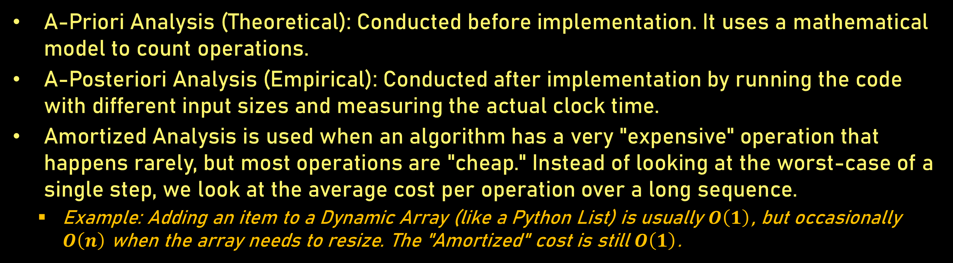
METHODS OF COMPLEXITY MEASUREMENT
Complexity is measured through two primary lenses:
A-Priori Analysis (Theoretical): Conducted before implementation. It uses a mathematical model to count operations.
A-Posteriori Analysis (Empirical): Conducted after implementation by running the code with different input sizes and measuring the actual clock time.
Amortized Analysis is used when an algorithm has a very "expensive" operation that happens rarely, but most operations are "cheap." Instead of looking at the worst-case of a single step, we look at the average cost per operation over a long sequence.
Example: Adding an item to a Dynamic Array (like a Python List) is usually $O\left(1\right)$ , but occasionally $O\left(n\right)$ when the array needs to resize. The "Amortized" cost is still $O\left(1\right)$ .

Slide 35
METHODS OF COMPLEXITY MEASUREMENT
Difference between A posteriori analysis and A Priori analysis:
A-Posteriori Analysis | A-Priori Analysis
Posteriori analysis is a relative analysis. | Priori analysis is an absolute analysis.
It is dependent on language of compiler and type of hardware. | It is independent of language of compiler and types of hardware.
It will give exact answer. | It will give approximate answer.
It doesn't use asymptotic notations to represent the time complexity of an algorithm. | It uses the asymptotic notations to represent how much time the algorithm will take in order to complete its execution.
The time complexity of an algorithm using a posteriori analysis differ from system to system. | The time complexity of an algorithm using a priori analysis is same for every system.
If the time taken by the program is less, then the credit will go to compiler and hardware. | If the algorithm running faster, credit goes to the programmer.
It is done after execution of an algorithm. | It is done before execution of an algorithm.
It is costlier than priori analysis because of requirement of software and hardware for execution. | It is cheaper than Posteriori Analysis.
Maintenance Phase is required to tune the algorithm. | Maintenance Phase is not required to tune the algorithm.

Slide 36
CHAPTER II:
PRELIMS
TREES

Slide 37
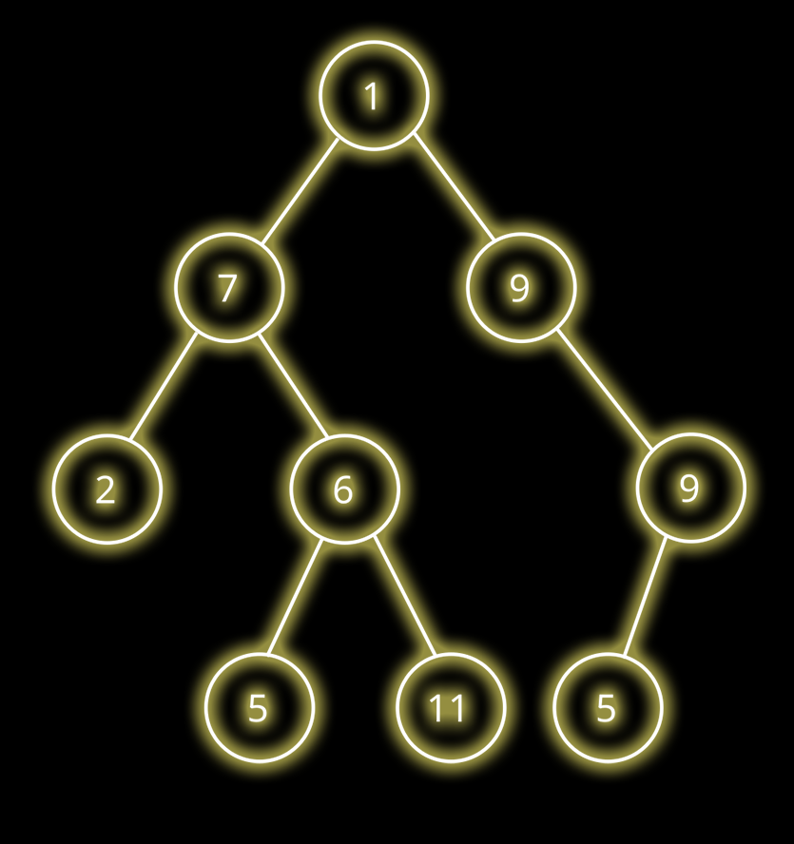
TERMINOLOGIES
Node: The basic unit containing data.
Root(Node): The top-most node (no parent).
Leaf: A node with no children.
Height: The number of edges on the longest path from the node to a leaf.
Depth: The number of edges from the root to the node.

Slide 38
TERMINOLOGIES
Node: The basic unit containing data.
Root(Node): The top-most node (no parent).
Leaf: A node with no children.
Height: The number of edges on the longest path from the node to a leaf.
Depth: The number of edges from the root to the node.

Slide 39
TERMINOLOGIES
Node: The basic unit containing data.
Root(Node): The top-most node (no parent).
Leaf: A node with no children.
Height: The number of edges on the longest path from the node to a leaf.
Depth: The number of edges from the root to the node.

Slide 40
TERMINOLOGIES
Node: The basic unit containing data.
Root(Node): The top-most node (no parent).
Leaf: A node with no children.
Height: The number of edges on the longest path from the node to a leaf.
Depth: The number of edges from the root to the node.

Slide 41
Height: 3
TERMINOLOGIES
Node: The basic unit containing data.
Root(Node): The top-most node (no parent).
Leaf: A node with no children.
Height: The number of edges on the
longest path from the node to a leaf.
Depth: The number of edges from the
root to the node.
Height: 2
Height: 1
Height: 0

Slide 42
Node: The basic unit containing data.
Root(Node): The top-most node (no parent).
Leaf: A node with no children.
Height: The number of edges on the
longest path from the node to a leaf.
Depth: The number of edges from the
root to the node.
Depth: 0
TERMINOLOGIES
Depth: 1
Depth: 2
Depth: 3

Slide 43
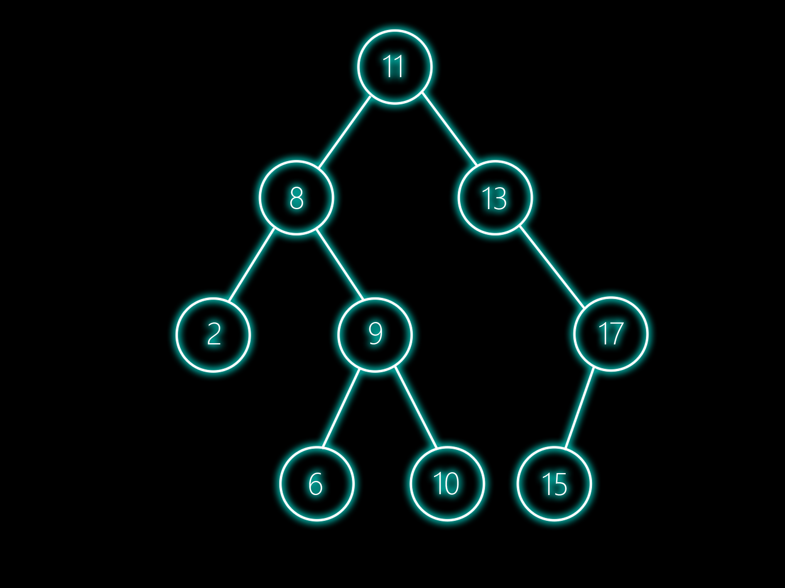
TERMINOLOGIES
BINARY SEARCH TREE
A BST is a specialized binary tree where:
The Left Subtree contains only nodes with keys less than the parent node.
The Right Subtree contains only nodes with keys greater than the parent node.

Slide 44
BINARY SEARCH TREE
BASIC OPERATIONS
Insertion: Adding a new node to the tree. In a Binary Search Tree (BST), we compare the new value to the root: if it’s smaller, we go left; if larger, we go right. This continues until we find an empty spot.
Insertion: Adding a new node to the tree. In a Binary Search Tree (BST), we compare the new value to the root: if it’s smaller, we go left; if larger, we go right. This continues until we find an empty spot.
Insertion: Adding a new node to the tree. In a Binary Search Tree (BST), we compare the new value to the root: if it’s smaller, we go left; if larger, we go right. This continues until we find an empty spot.
Insertion: Adding a new node to the tree. In a Binary Search Tree (BST), we compare the new value to the root: if it’s smaller, we go left; if larger, we go right. This continues until we find an empty spot.

Slide 45
BINARY SEARCH TREE
BASIC OPERATIONS
Deletion: Removing a node. This is the trickiest part because you have to "patch" the hole.
Leaf node: Just remove it.
One child: The child moves up to take the parent's place.
Two children: You usually replace the node with its in-order successor (the smallest value in the right subtree).

Slide 46
BINARY SEARCH TREE
BASIC OPERATIONS
Traversal: The process of visiting every node in the tree exactly once.
Pre-Order
In-Order
Post-Order
Level-Order

Slide 47
BINARY SEARCH TREE
BASIC OPERATIONS
Assignment:
List the nodes in the order they are visited for each of these traversals:
In-Order
Pre-Order
Post-Order
Level-Order

